Slide 1
Project 1
Jensen Judkins & Linhao Wu

Slide 2



Analysis 1 - Average Annual Appearances
Idea Breakdown - How has external factors (economic, war, coaching) effected players returning on an annual basis to play? What can we expect/foretell in the future?

Slide 3
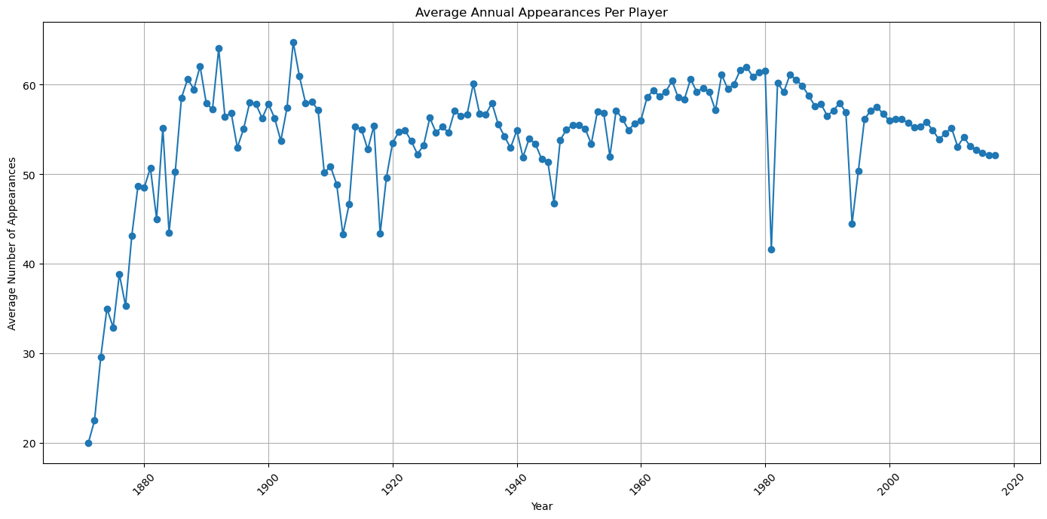
Analysis 1 - Average Annual Appearances

Slide 4
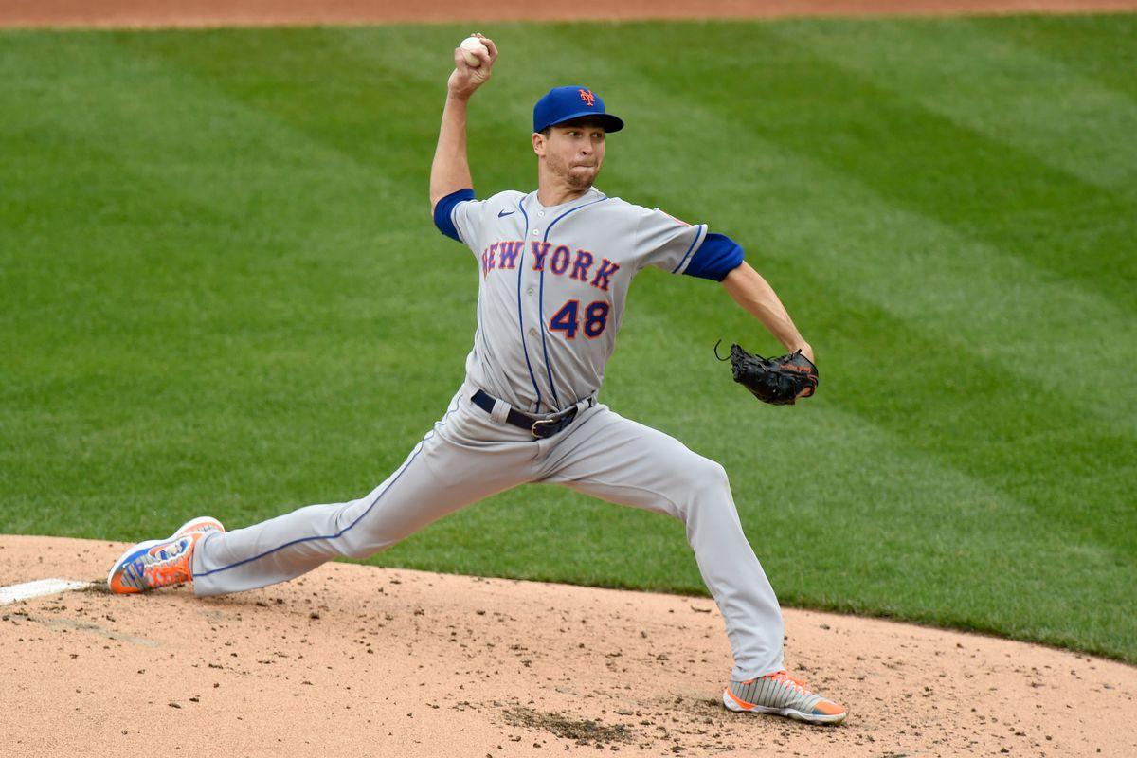

Analysis 2 - Annual Appearances in Relation to Position
Idea Breakdown - Team sports have “skill positions”, neither of us have a background in baseball so we wanted to know which positions have the most “franchise worthy” players which stay for multiple years in comparison to their peers, and what positions feature the most rotations on an annual basis.

Slide 5
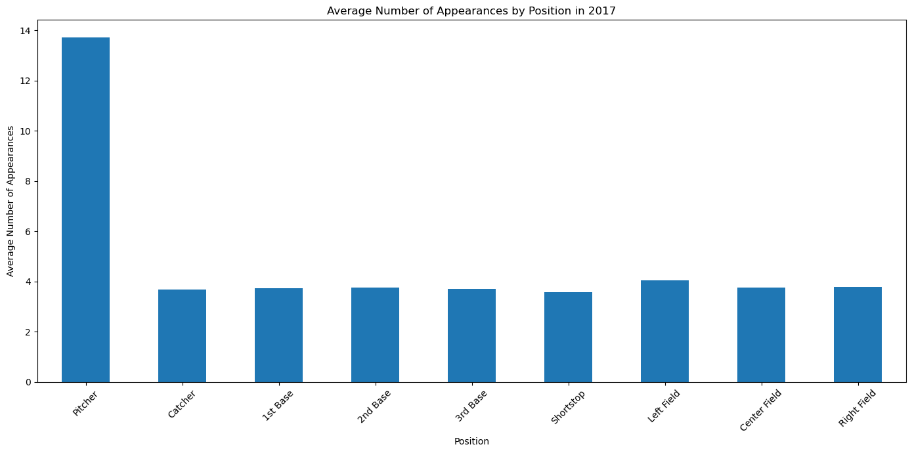
Analysis 2 - Annual Appearances in Relation to Position

Slide 6
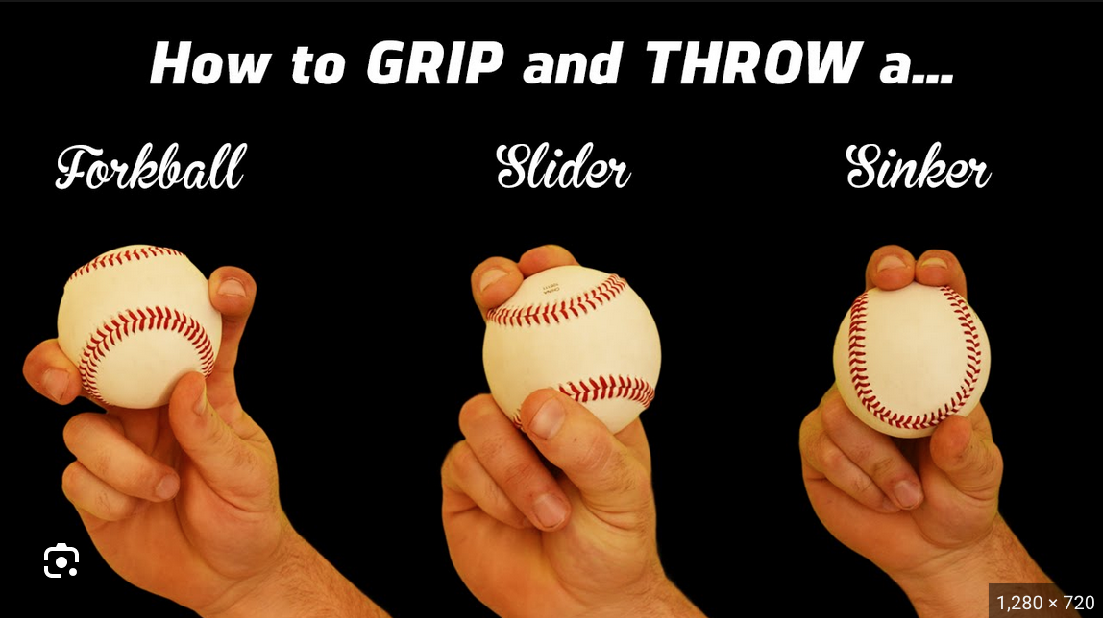
Analysis 3 - Comparison of Wild Pitches to Hits
Idea breakdown - The more difficult the pitch is to hit, the same is true for it to catch. Thus we can infer that the more “wild pitches” there are in a year, the more pitchers were experimenting with different throwing styles to try and make hitting more difficult.

Slide 7
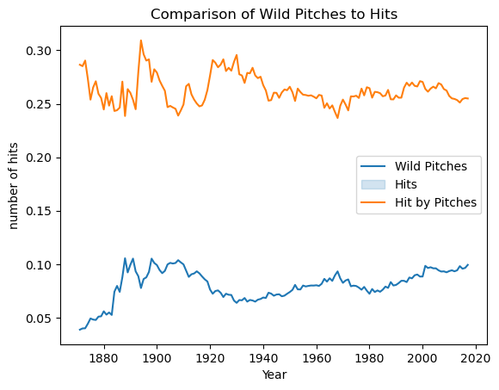
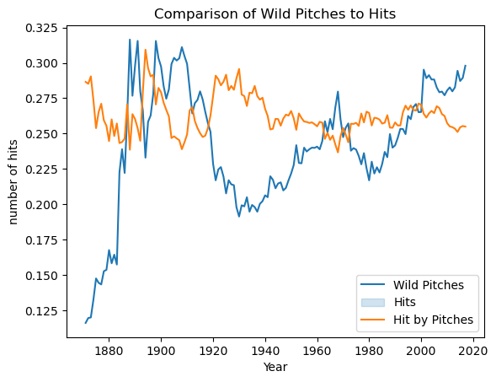
Analysis 3 - Comparison of Wild Pitches to Hits
(Scaled 3x for wild pitches)

Slide 8
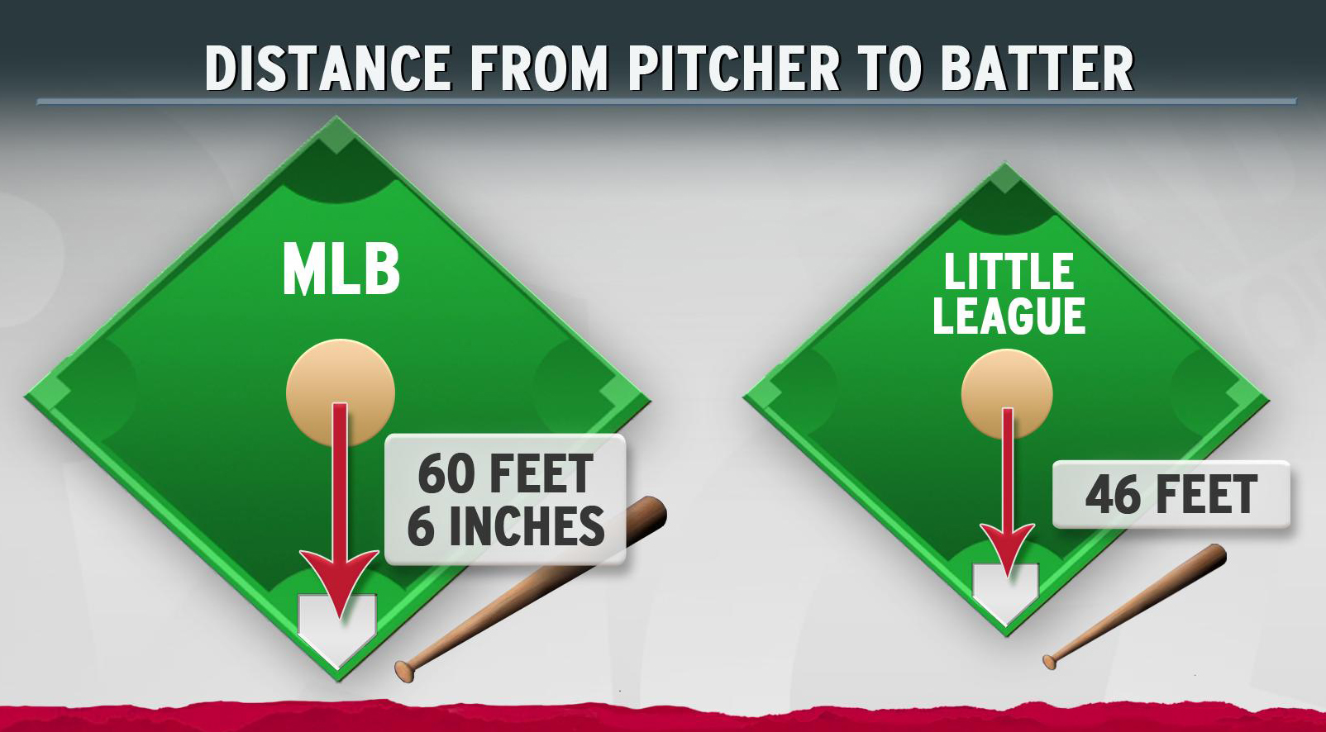
Idea breakdown - The further away the pitcher's mound is from the batter, the easier it is to hit. Creating more offensive plays. How did moving the mound in 1893 ~20% further back effect batting averages, and was it a substantial enough change?

Slide 9
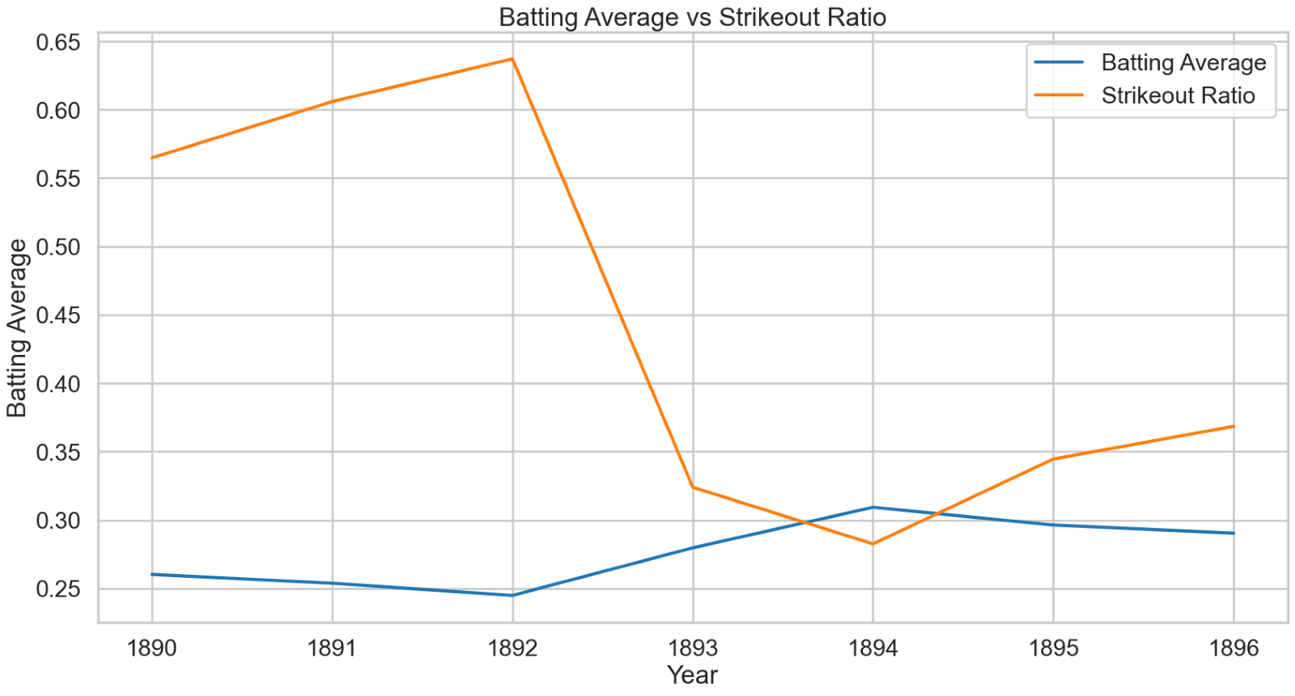
Analysis 4 - Effects on Relocation of Pitching Mound (1893)

Slide 10
Questions?

